Slide 1





Group Presentation
of
Introduction To Software Engineering
Course Code : SE113
Teacher: Mr. Md Rajib Mia

Slide 2





Our Group
MD. HASIBUL HASAN HASIB
OCEAN MALLIK
PRESENTS YOU
Extreme Programming (XP)
An Agile Software Development Methodology

Slide 3





INTRODUCTION
Extreme Programming (XP) is an Agile software development methodology.
It focuses on flexibility, team collaboration, and quick customer feedback.
XP aims to produce high-quality software and adapt rapidly to changing requirements.
It pushes common programming practices—like testing, communication, and simplicity—to an extreme level.

Slide 4



History of XP
XP was created by Kent Beck in the late 1990s.
It originated during the Chrysler C3 payroll system project.
The team faced frequent requirement changes, so Beck introduced XP to handle these changes effectively.
XP later became a major Agile method alongside Scrum.
Late 1990s
1996
1999

Slide 5
USER STORIES
PAIR PROGRAMMING
Customer explains requirements in short, clear stories.
01
05
Two developers work together at one computer to write better and more reliable code.
PLANNING GAME
02
06
TESTING(TDD)
Team and customer decide priorities and what to develop first.
Tests are written before coding and run continuously.
WORKING PROCESS
SHORT INTERATION
03
07
CONTINOUS INTEGRATION
Each cycle delivers a small, working version of the product.
Code is frequently merged and tested to detect errors early.
SIMPLE DESIGN
04
08
CUSTOMER FEEDBACK
Design only what is necessary right now to keep the code clean and easy to change.
After each iteration, the customer reviews the product and suggests improvements.

Slide 6
Pair Programming
Test-Driven Development (TDD)
CORE PRACTICES
Continuous Integration
Simple Design
Small, Frequent Releases
On-Site Customer
Refactoring
Collective Code Ownership

Slide 7
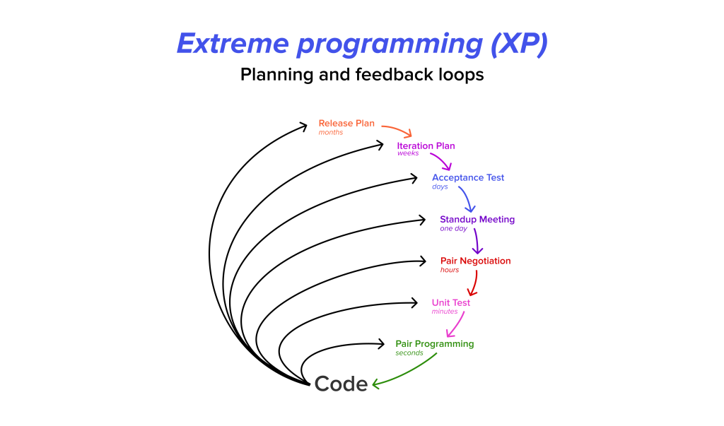
The values of XP
Communication
Feedback
Simplicity
Courage
Respect

Slide 8

Advantages of XP
Fewer bugs
High quality code
Constant improvement
Fast feedback from customers
Flexible with changing requirements

Slide 9
Disadvantages of XP
Requires high customer involvement
Pair programming can be expensive
Hard to apply in large teams
Needs highly skilled developers

Slide 10

When to use?
When not to use?
Fast-changing requirements
Small to medium teams
Highly technical projects
Projects needing high-quality code quickly
Large enterprise projects
Customer unavailable
Team is inexperienced

Slide 11
Thank You

